Slide 1
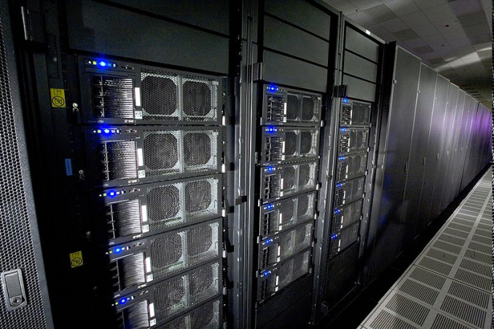
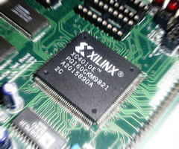
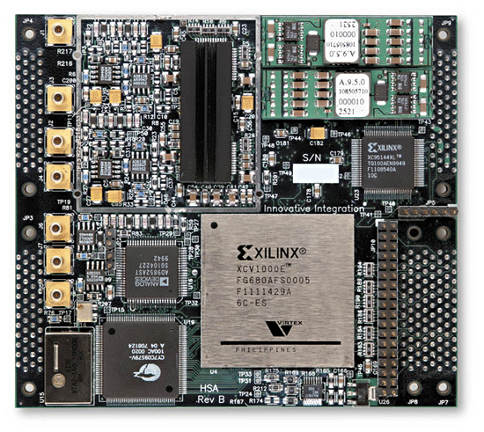
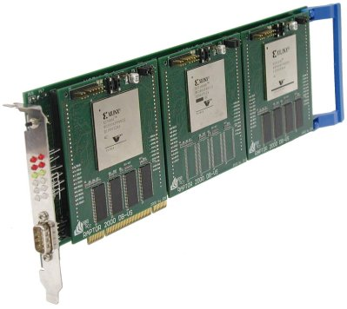
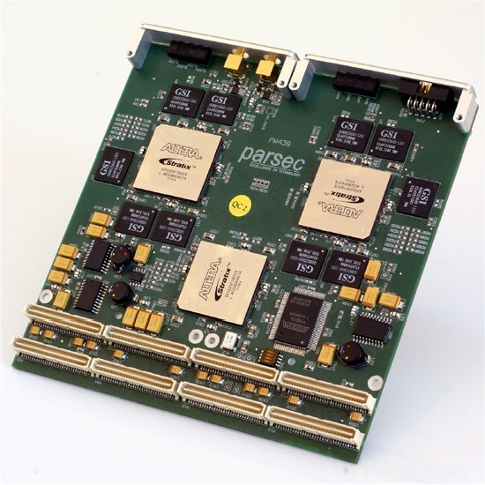
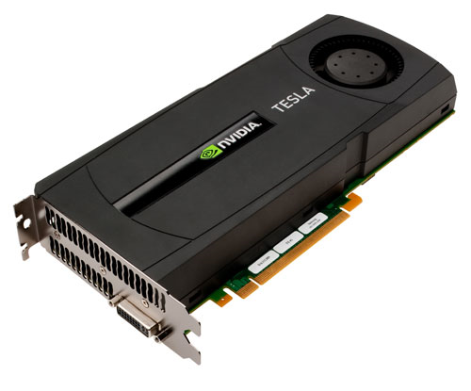

Heterogeneous Computing at USC Dept. of Computer Science and Engineering University of South Carolina
Dr. Jason D. Bakos
Associate Professor
Heterogeneous and Reconfigurable Computing Lab (HeRC)
This material is based upon work supported by the National Science Foundation under Grant Nos. CCF-0844951 and CCF-0915608.

Slide 2
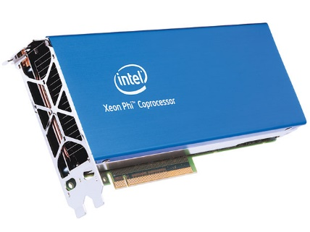
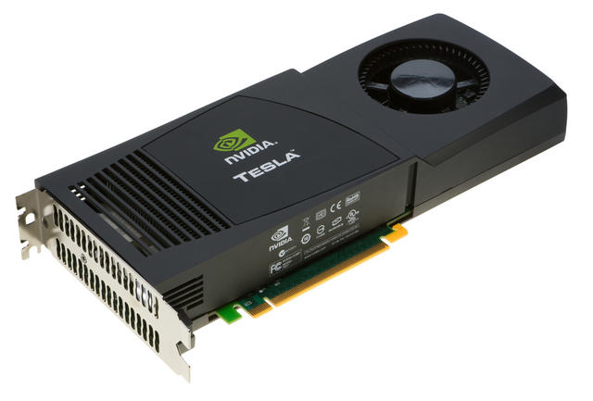
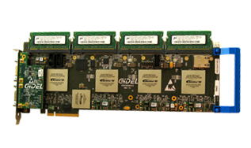
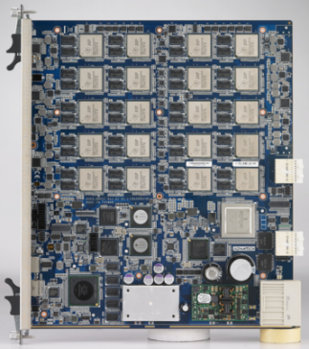
Heterogeneous and Reconfigurable Computing Lab
Mission: Develop practices and tools to harness emerging processing technologies
Emerging technologies address current limitations, e.g.:
100 quadrillion ops/sec limit for large-scale computers
Mobile processors can’t execute advanced computer vision and machine learning tasks in real time while maintaining acceptable power envelope
Manycore Processors:
Programmable Logic:
Digital Signal Processors:

Slide 3
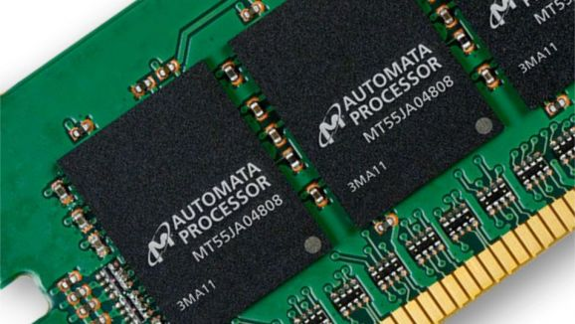
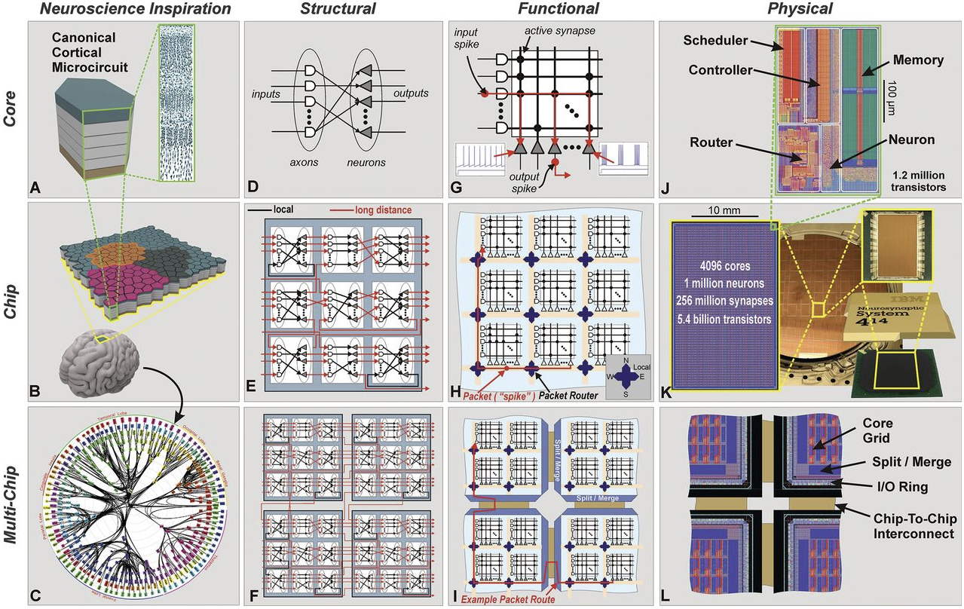
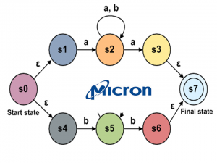
Emerging Technologies
Micron Automata Processor:
IBM Neurosynaptic Processor

Slide 4
Outline
Heterogeneous computing, why?
“Emerging” processor technology:
GPGPU architecture and programming
FPGA architecture and programming
DSP architecture and programming
Applications:
Linear algebra
Computer vision
Computational biology
Data mining
Tools:
Pipeline synthesis
Domain specific language
Automatic scratchpad allocation

Slide 5
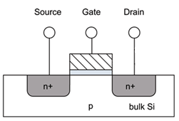
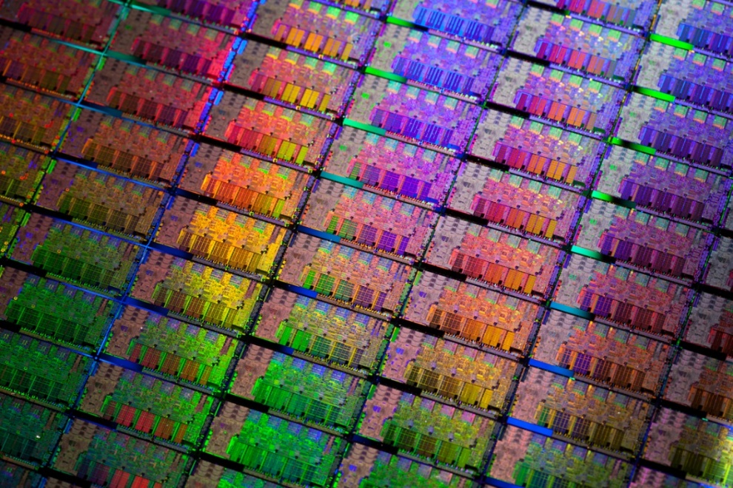
CMOS Technology Scaling

Slide 6
CMOS Technology Scaling
Year | Processor | Performance | Transistor Size | Transistors
1982 | i286 | 6 - 25 MHz | 1.5 μm | ~134,000
1986 | i386 | 16 – 40 MHz | 1 μm | ~270,000
1989 | i486 | 16 - 133 MHz | .8 μm | ~1 million
1993 | Pentium | 60 - 300 MHz | .6 μm | ~3 million
1995 | Pentium Pro | 150 - 200 MHz | .5 μm | ~4 million
1997 | Pentium II | 233 - 450 MHz | .35 μm | ~5 million
1999 | Pentium III | 450 – 1400 MHz | .25 μm | ~10 million
2000 | Pentium 4 | 1.3 – 3.8 GHz | 180 nm | ~50 million
2005 | Pentium D | 2 cores/package | 90 nm | ~200 million
2006 | Core 2 | 2 cores/chip | 65 nm | ~300 million
2008 | “Nehalem” | 4 cores/chip | 45 nm | ~800 million
2010-11 | “Westmere” / “Sandy Bridge” | 6 cores/chip | 32 nm | ~1.2 billion
2012-13 | “Ivy Bridge” / ”Haswell” | 8 cores/chip | 22 nm | ~1.4 billion
2014-15 | “Broadwell” / ”Skylake” | 4 cores/chip (18 for EP) | 14 nm | ?
Moore’s 18-mo cycle begins
End of frequency scaling
End of core scaling?
Year | GPGPU | Speed | Transistor Size | Transistors
2008 | NVIDIA Tesla (GT200) | 30 cores(x16)/die | .065 μm | 1.4 billion
2010 | NVIDIA Fermi (GF110) | 15 cores(x32)/die | .040 μm | 3.0 billion
2012 | NVNDIA Kepler (GK110) | 15 cores (x32)/die | .028 μm | 3.5 billion
End of core scaling?

Slide 7
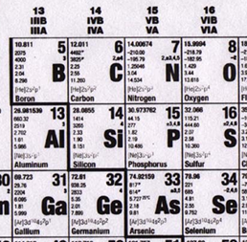
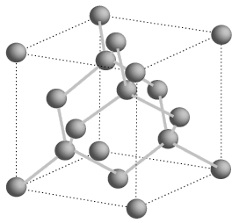
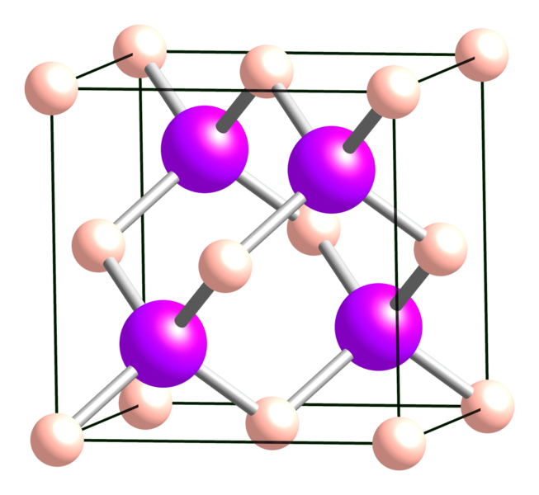
Semiconductors
Si unit cell:
Atom spacing = .543 nm
Cell size = 5.43 nm
GaAs unit cell:
Atom spacing = ? nm
Cell size = ~2 nm?
End of Moore’s Law means:
Architects must drive performance with with fixed real estate
Fabs may increase yield, drive down price
Result: more specialization in processing technology

Slide 8
Microarchitecture
Core 1
Core 2
CPU
Control
ALU
ALU
Control
ALU
ALU
Memory
ALU
ALU
ALU
ALU
25.6 GB/s
L1 cache
L1 cache
L2 cache
L2 cache
DDR3 800 MHz
~90% ach. efficiency
L3 cache
GOALs: avoid off-chip access, achieve high memory utilization and instruction throughput (even for control-dependent code)
Low floating point throughput

Slide 9
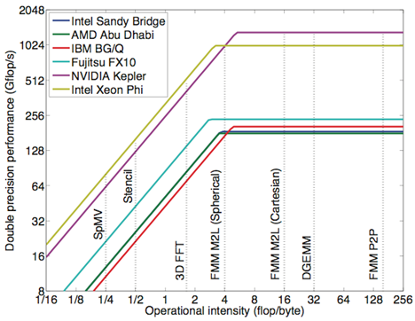
CPU Problem: Memory Wall
Regular loops:
for (i=0;i<n;i++)
a[i]+=a[i]*b[i]*c
3 ops per 8 bytes
Intensity = 3/8
For applications on the slope:
performance = I x bw

Slide 10
GPU Design
GPU
cache
ALU
ALU
ALU
ALU
ALU
ALU
ALU
ALU
Core 1
Memory
300 GB/s
cache
ALU
ALU
ALU
ALU
ALU
ALU
ALU
ALU
Core 2
cache
ALU
ALU
ALU
ALU
ALU
ALU
ALU
ALU
Core 3
6 DDR5 6GHz
~30% efficiency
Still 3X more than CPU
cache
ALU
ALU
ALU
ALU
ALU
ALU
ALU
ALU
Core 4
cache
ALU
ALU
ALU
ALU
ALU
ALU
ALU
ALU
Core 5
Advantages:
Higher floating point throughput than CPU for data parallel (control agnostic) code
Disadvantage:
Latency; needs host CPU for I/O
Programming!
cache
ALU
ALU
ALU
ALU
ALU
ALU
ALU
ALU
Core 6
cache
ALU
ALU
ALU
ALU
ALU
ALU
ALU
ALU
Core 7
cache
ALU
ALU
ALU
ALU
ALU
ALU
ALU
ALU
Core 8

Slide 11
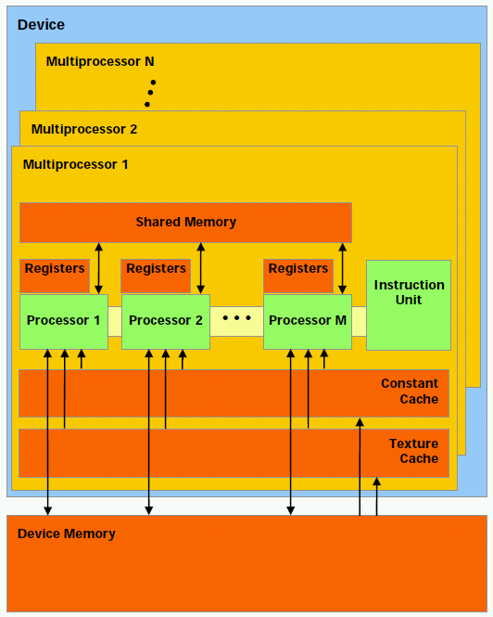
NVIDIA GPU Architecture
Hundreds of simple processor cores
Core design:
Only one instruction from each thread active in the pipeline at a time
In-order execution
No branch prediction
No speculative execution
No support for context switches
No system support (syscalls, etc.)
Small, simple caches
Programmer-managed on-chip scratch memory

Slide 12
Programming GPUs
HOST (CPU) code:
dim3 grid,block;
grid.x=((VECTOR_SIZE/512) + (VECTOR_SIZE%512?1:0));
block.x=512;
cudaMemcpy(a_device,a,VECTOR_SIZE * sizeof(double),cudaMemcpyHostToDevice);
cudaMemcpy(b_device,b,VECTOR_SIZE * sizeof(double),cudaMemcpyHostToDevice);
vector_add_device<<<grid,block>>>(a_device,b_device,c_device);
cudaMemcpy(c_gpu,c_device,VECTOR_SIZE * sizeof(double),cudaMemcpyDeviceToHost);
GPU code:
__global__ void vector_add_device (double *a,double *b,double *c) {
__shared__ double a_s,b_s,c_s;
a_s=a[blockIdx.x*blockDim.x+threadIdx.x];
b_s=b[blockIdx.x*blockDim.x+threadIdx.x];
c_s=a_s+b_s;
c[blockIdx.x*blockDim.x+threadIdx.x]=c_s;
}

Slide 13
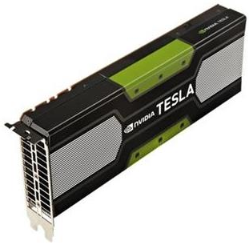
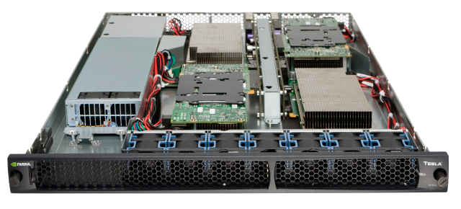
Heterogeneous Computing with GPUs
NVIDIA Tesla S1070

Slide 14
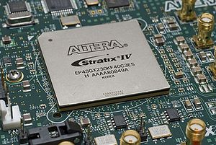
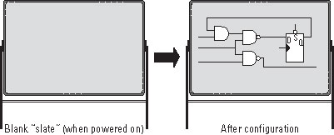
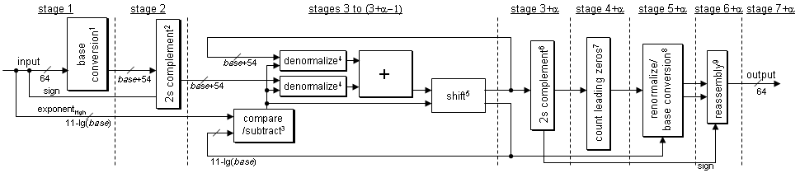
FPGA Design
Advantage:
100% of hardware can directly contribute to computation, high hardware efficiency
Directly connect to I/O devices, achieve low latency
Disadvantage:
I/O pins are slow, low memory bandwidth
Programming!
GOAL: achieve 100% hardware efficiency
ideal for latency-sensitive applications

Slide 15
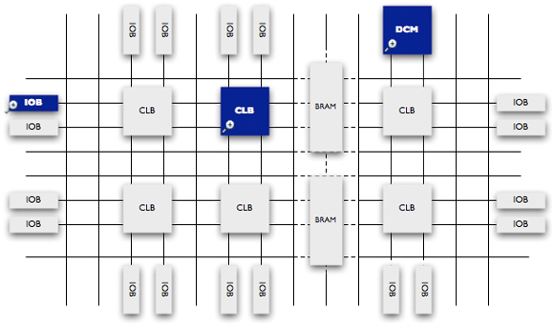
Field Programmable Gate Arrays

Slide 16
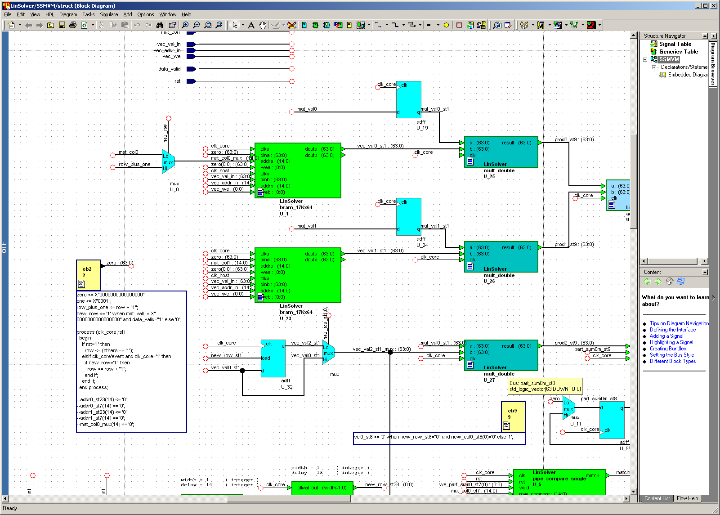
Programming FPGAs

Slide 17
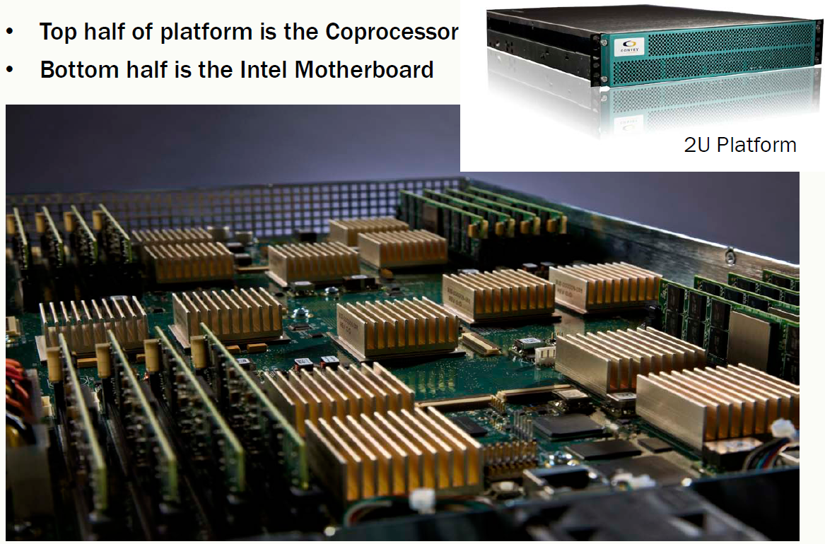
Heterogeneous Computing with FPGAs
Convey HC-1

Slide 18
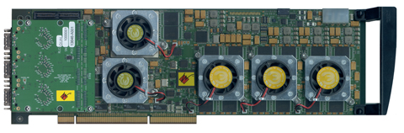
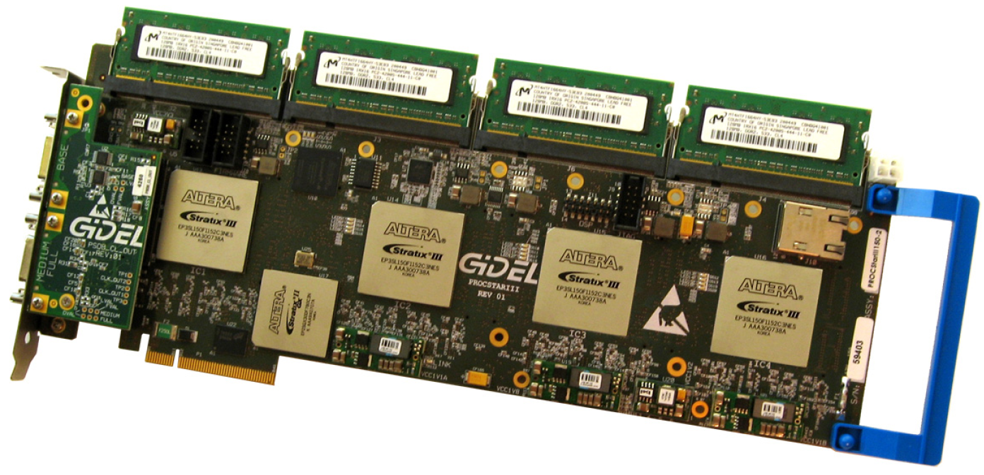
Heterogeneous Computing with FPGAs
Annapolis Micro Systems
WILDSTAR 2 PRO
GiDEL PROCSTAR III

Slide 19
DSP Design
Four ARM A15 cores + eight DSP cores
Advantages:
Compiler extracts ILP with VLIW, no power hungry dynamic instruction scheduling
Simple caches, but offers compiler controlled scratchpad memory + DMA
➔ Possibly more Gflops/Watt than GPU and CPU
On-chip interfaces for potential multichip scalability
4 x 5 Gb/s Serial Rapid IO 2.1, 1 x 10 Gb/s Ethernet, 2 x 5 Gb/s PCI-E 2.0, 1 x 50 Gb/s HyperLink
Disadvantages:
Lower peak ops/s and memory bandwidth than CPU and GPU
Programming!

Slide 20
VLIW and Software Pipeline
for i = 0 to n
$1 = load A[i]
add $2,$2,$1
A[i] = store $2
endfor
Regular Loop
After Schedule
L
L
7 cycles
A
L
A
Load 3 cycles
Add 3 cycles
S
S
A
L
3
cycles
Store 1 cycles
S
A
Software Pipeline Restrictions:
Not friendly to conditional code inside loop body
Register limitations
Rely on compiler to exert the optimization in low level
VLIW Software
Pipelined Loop with static scheduler
Out-of-order Processor with dynamic scheduler
S
Notes:
Practical limitation, branches, register, assembly(parallel not happen obviously, lower level than C), 3 cycles add

Slide 21
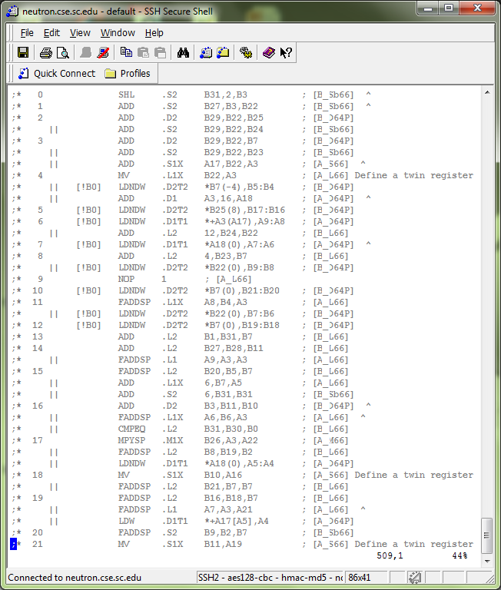
Programming DSPs (Computation)
void harrisCorner (__global float *restrict input1 __global float *restrict input2,
__global float *restrict output) {
int i; double in0d,in1d; float in0,in1,xx,xy,yy,t;
_nassert((int)input1 % 8 == 0);
_nassert((int)input2 % 8 == 0);
_nassert((int)output % 8 == 0);
#pragma MUST_ITERATE(8,2,2)
#pragma UNROLL
for (i=0;i<n;i++) {
in0d = _amemd8((void*)(input1 + 0 + i * 2));
in0 = *((float2 *)&in0d);
in1d = _amemd8((void*)(input2 + 0 + i * 2));
in1 = *((float2 *)&in1d);
xx = in0*in0;
xy = in1*in0;
yy = in1*in1;
t = xx + yy - 0.11f * xy;
_amemd8((void*)(output + 0 + i * 2)) = *((double*)&t);
}
}

Slide 22
DSP Memory Hierarchy
 | Size (KB) | Cache Capacity(KB)
L1P | 32 | 0/4/8/16/32
L1D | 32 | 0/4/8/16/32
L2 | 1024 | 0/32/64/128/256/512/1024
MSMC | 6144 | 0
SPRAM
Cache
SPRAM
Cache
SPRAM
Cache
1024K Level 2 SRAM
Notes:
Text book style simple cache
Cache could also be SPM
Share memory could be SPM

Slide 23
SPM Method and Double Buffer
Time
Load 0
Load 1
Load 0
EDMA
DSP
Corepac
Compute 0
Compute 1
Compute 0
Notes:
2 stages could be pipelined
Loop tilling + double buffer is basic optimization strategy in the DSP platform.

Slide 24
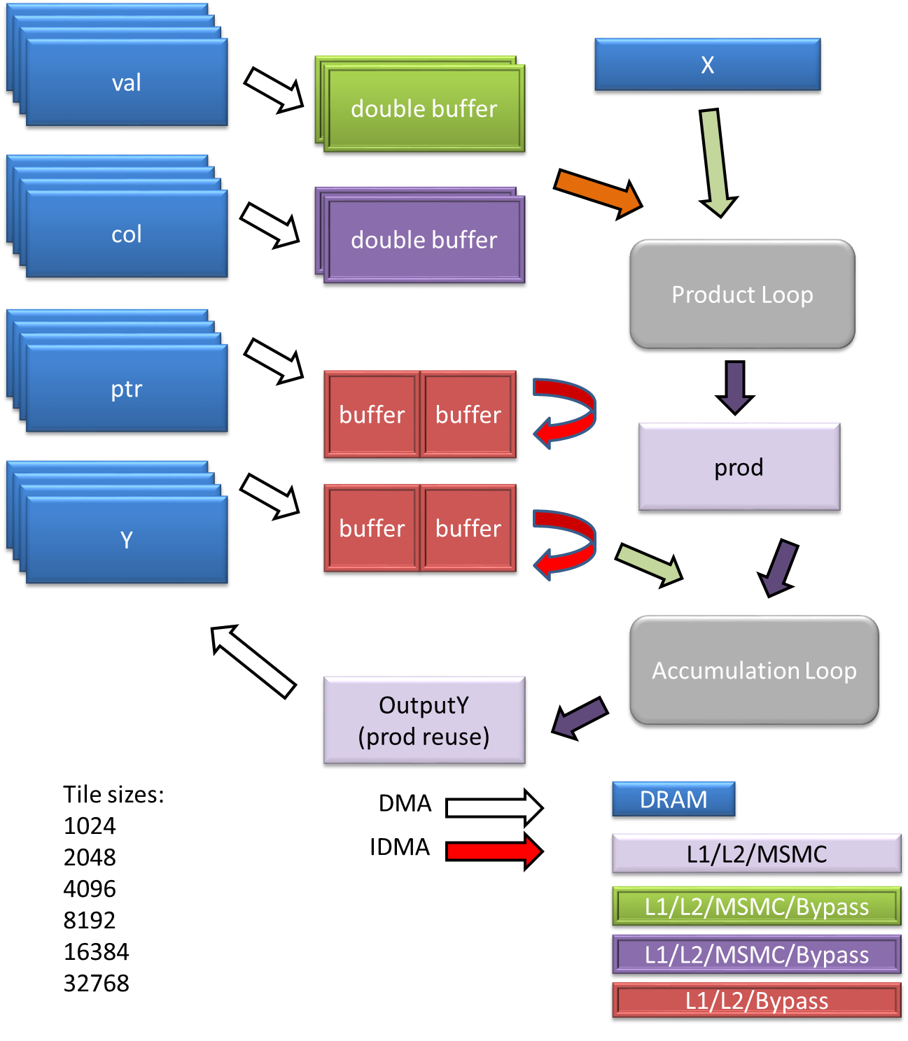
Programming DSPs (Memory)
if (spmv_conf.val_loc == ARRAY_LOC_MSMC)
CACHE_invL1d(csrValA_act, spmv_conf.tilesize, CACHE_WAIT);
if (spmv_conf.col_loc == ARRAY_LOC_MSMC)
CACHE_invL1d(csrColIndA_act, spmv_conf.tilesize, CACHE_WAIT);
//wait for QDMA transfer completion
if (spmv_conf.col_loc != ARRAY_LOC_DDR)
edmaWait4Completion(EDMA_COL);
if (spmv_conf.val_loc != ARRAY_LOC_DDR)
edmaWait4Completion(EDMA_VAL);
//second load from DMA
if (spmv_conf.val_loc != ARRAY_LOC_DDR)
edmaInitiateXfer((void*) (csrValA_act), &csrValA[i],
spmv_conf.tilesize,1,1,1,1,1,1,EDMA_VAL);
if (spmv_conf.col_loc != ARRAY_LOC_DDR)
edmaInitiateXfer((void*) (csrColIndA_act), &csrColIndA[i],
spmv_conf.tilesize,1,1,1,1,1,1,EDMA_COL);

Slide 25
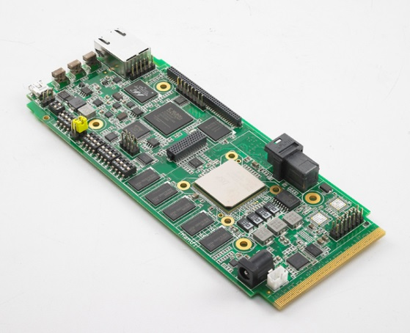
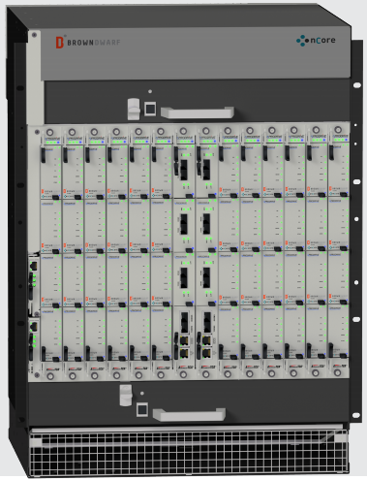
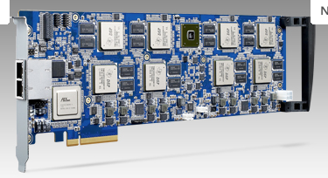
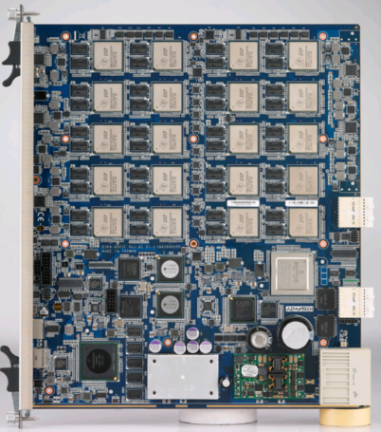
C66 Platforms
Development and evaluation: High Performance Computing:

Slide 26
TI C66 DSP vs. Other Processors
 | NVIDIA Tesla K20X GPU 28 nm | Intel Xeon Phi 5110p 22 nm | Intel i7 Ivy Bridge 22 nm | TI Keystone 2 28 nm | NVIDIA Tegra 4 28 nm | Intel i3 Ivy Bridge 22 nm
Peak single precision throughput | 3.95 Tflops | 2.12 Tflops | 448 Gflops | 48 Gflops (ARM) 173 Gflops (DSP@1.35 GHz) | 48 Gflops (ARM) 327 Gflops (GPU@852 MHz) | 42 Gflops
TDP | 225 W | 225 W | 77 W | 10 W | 8 W | 55 W
Ideal DRAM bandwidth | 250 GB/s | 320 GB/s | 25.6 GB/s Dual Channel DDR3 | 12.8 GB/s Single Channel DDR3 | 17 GB/s Single Channel DDR | 25.6 GB/s Dual Channel DDR3
Ideal power efficiency | 17.6 Gflops/ Watt | 9.4 Gflops/ Watt | 5.8 Gflops/ Watt | 17.3 Gflops/ Watt (DSP) | 40.9 Gflops/ Watt (GPU) | < 1 Gflops/ Watt

Slide 27
Heterogeneous Computing
Subfield of computer architecture
Mix general-purpose CPUs with specialized processors
Becoming increasingly popular with high integration densities
GOALs:
Explore the use of specialized processor designs that are designed with radically different designs than traditional CPUs
Develop new programming models and methodologies for these processors

Slide 28
Heterogeneous Computing
Combine CPUs and coprocs
Example:
Application requires a week of CPU time
Offload computation consumes 99% of execution time
49% of code
initialization
0.5% of run time
“hot” loop
99% of run time
2% of code
Kernel speedup | Application speedup | Execution time
50 | 34 | 5.0 hours
100 | 50 | 3.3 hours
200 | 67 | 2.5 hours
500 | 83 | 2.0 hours
1000 | 91 | 1.8 hours
49% of code
clean up
0.5% of run time
co-processor

Slide 29
Heterogeneous Computing
Only CPUs can run O/S
General purpose CPU + special-purpose processors in one system
System I/O controller
Host Memory
CPU
QPI
PCIe
On board
Memory
X58
Co-processor
~25 GB/s
~25 GB/s
~8 GB/s (x16)
?????
~150 GB/s for GeForce 260
host
add-in card

Slide 30
Linear Algebra
[FPGA, DSP]

Slide 31
Streaming Double Precision Accumulation
FPGAs allow data to be “streamed” into a computational pipeline
Many kernels targeted for acceleration include
Such as: dot product, used for MVM: kernel for many methods
For large datasets, values delivered serially to an accumulator
Reduction operation
Σ
G+H+I,
set 3
D+E+F,
set 2
A+B+C,
set 1
I,
set 3
H,
set 3
G,
set 3
F,
set 2
E,
set 2
D,
set 2
C,
set 1
B,
set 1
A,
set 1

Slide 32
The Reduction Problem
Basic Accumulator Architecture
Feedback Loop
+
Adder Pipeline
Partial sums
Reduction Ckt
Control
Required Design
Mem
Mem

Slide 33
High Throughput Accumulation
Buffers
Accumulator Input
c₂
Adder Pipeline
?
d₁
?
?
c₁
B_{sum}
A_{sum}
?
c₃
Dynamically schedule:
Adder inputs
Next input value
Output of adder
…based on datapath priorities and the set IDs

Slide 34
Accumulator Design
Rule 2
c₂
d₁
c₁
B_{sum}
A_{sum}
c₃
Rule 4
d₁
d₂
c₂+c₃
c₁
B_{sum}

Slide 35
Accumulator Design
Rule 5
d₃
D1+d2
C2+c3
c₁
0
Rule 1
c₁
d₄
d₃
d₁+d₂
c₂+c₃

Slide 36
Inaccuracies in Floating Point Addition
Floating point addition has inherent rounding error
Shift, round, cancellation
F.p. addition is not associative
For the accumulator, the total error is data dependent
We’ve seen as many as 50% of mantissa bits being in error after accumulating large synthetic data sets
In general, to improve accuracy:
multiple passes over dataset (sorting),
multiple operations per input (additional dependencies), or
increased precision (lower clock rate, higher latency)
…each reduces throughput

Slide 37
Compensated Summation
Compensated summation
Preserve the rounding error from each addition
Incorporate the errors into the final result
Three strategies:
Incorporate rounding errors from previous addition into subsequent addition
Accumulate the error separately and incorporate total error into the final result
Use extended precision adder (80- and 128-bit)
Error Free Transformation
a + b = x + e, x = fl(a ⊕ b)

Slide 38
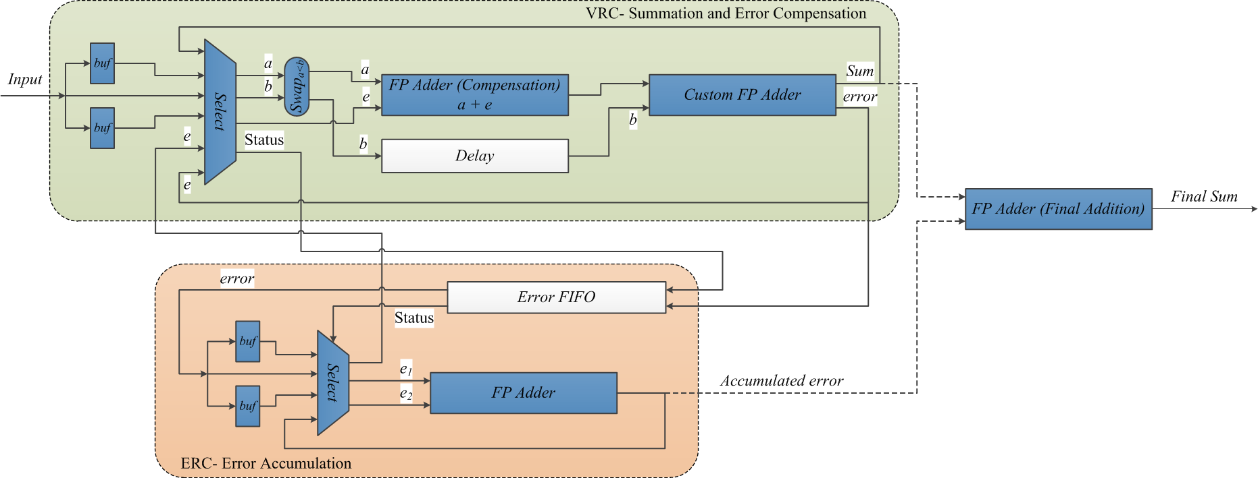
Adaptive Error Compensation in Subsequent Addition (AECSA)

Slide 39
Accumulated Error Compensation
Accumulate the extracted error, compensate in the end
Value Reduction Circuit (VRC)
Sum
a
Select
Custom Adder
Input FIFO
b
Error Set Status
FP Adder
Final Result
Error FIFO
Input Error
e₁
Error
Select
FP Adder
e₂
Error Reduction Circuit (ERC)

Slide 40
Preview of Results
Varying к and Exp. Range = 32, Set Size = 100
$$κ=\frac{\sum_{i=1}^{n}{|ai|}}{|\sum_{i=1}^{n}{ai|}}$$
Number of LSBs in Mantissa in Error
(Compared with infinite precision)
Exp. Range | к | Red. Ckt. | AECSA | AEC | EPRC80 | EPRC128
32 | 10.0 | 1.6 | 0 | 0 | 0 | 0
32 | 95.0 | 3.5 | 0.3 | 0.3 | 0.2 | 0.2
32 | 800.0 | 4.2 | 0.7 | 0.6 | 0.3 | 0.3
32 | 1600.0 | 7.7 | 0.9 | 0.7 | 0.4 | 0.4
32 | 6000.0 | 7.9 | 1.4 | 1.1 | 1.1 | 0.9
32 | 11000.0 | 8.3 | 2.5 | 1.6 | 1.4 | 1.4

Slide 41
Sparse Matrix-Vector Multiply
0
1
2
3
4
5
6
7
8
9
10
A
0
0
0
B
0
val
A
B
C
D
E
F
G
H
I
J
K
0
0
0
C
0
D
E
0
0
0
F
G
col
0
4
3
5
0
4
5
0
2
4
3
H
0
0
0
0
0
0
0
I
0
J
0
ptr
0
2
4
7
8
10
11
0
0
0
K
0
0
Group vol/col
Zero-terminate
(A,0) (B,4) (0,0) (C,3) (D,4) (0,0)…

Slide 42
Sparse Matrix-Vector Multiply
Code for y = Aαx + βy
row = 0
for i = 0 to number_of_nonzero_elements do
if i == ptr[row+1] then row=row+1, y[row]*=beta;
y[row] = y[row] + alpha * A[i] * x[col[i]]
end
conditional execution
reduction
Low arithmetic intensity
(~3 flops / 24 bytes)
Memory bound kernel
indirect indexing
Notes:
Indirect indexing: load dependence.
Utilization 6ALU+2L/S
Dependency
Software pipelining

Slide 43
Performance Comparison
If FPGA Memory bandwidth scaled by adding multipliers/ accumulators to match GPU Memory Bandwidth for each matrix separately

Slide 44
Buffer Location and Performance
Non-zeros per row | val | col | ptr | y | prod | Gflops | Norm. Perf | Note
3 | S S L2 C | L2 L2 L2 C | L2 L2 C C | L2 L2 C C | L1 L2 S C | 2.26 1.84 1.23 1.44 | 1.57 1.28 0.85 1 | Best Median Worst² All cache
151 | L2 S C C | S C C C | L2 L2 C C | L2 L2 C C | L2 S L2 C | 3.76 3.55 2.66 2.51 | 1.50 1.41 1.06 1 | Best Median Worst² All cache
L1: level 1 SPRAM, L2:level 2 SPRAM, S:MSMC, C:cache
1: The results are normalized to the all cache configuration
2: The worst amongst the configurations with SPRAM
Notes:
Matrix: synthetic matrix, dense and sparse
Variance, mapping is important
Cache is not worst.
Not the kernel, the input data is also important

Slide 45
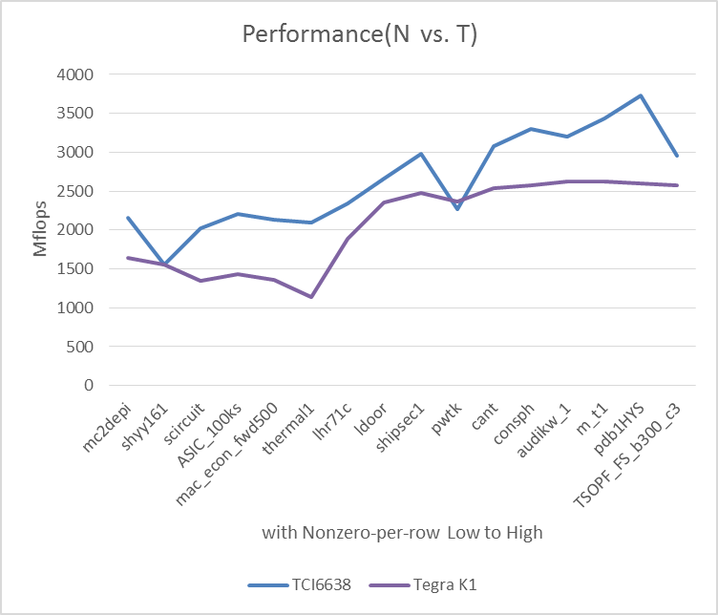
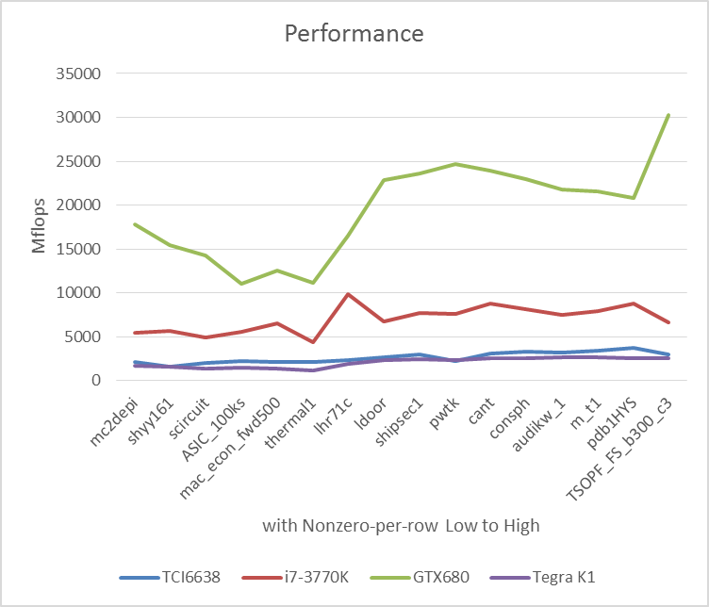
Performance Comparison vs. Nvidia TK1

Slide 46
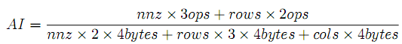
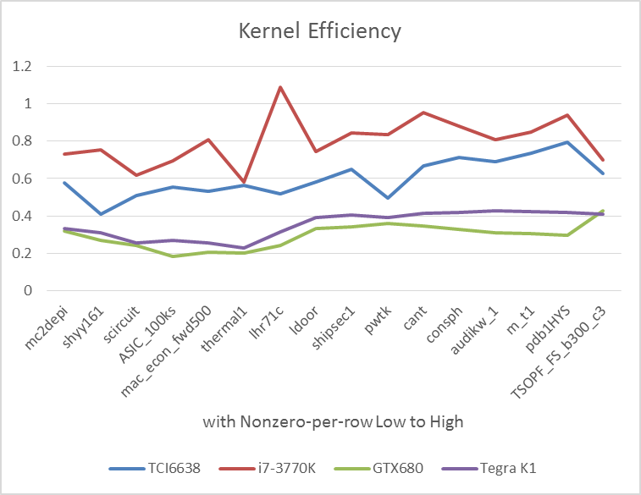
Kernel/Memory Efficiency
efficiency =
observed performance/((Arithmetic Intensity) X (Memory Bandwidth))

Slide 47
Results from Previous Work
Single precision CSR sparse matrix vector multiply kernel (SpMV):
Memory bound (~0.25 flops/byte)
Control dependent
Achieves 0.7 raw performance vs. Intel MKL on Ivy Bridge-i7
Achieves 0.1 raw performance vs. NVIDIA CUBLAS on GTX680 Keplar
Achieves 5X Gflops/Watt vs. Intel Ivy Bridge-i7
Achieves equal Gflops/Watt vs. NVIDIA GTX680 Keplar
Uses 50% more of its peak DRAM b/w (.6 to .9) vs. Intel Sandy Bridge-i7
Uses 3X more of its peak DRAM b/w (.3 to .9) vs. NVIDIA GTX680
Yang Gao, Jason D. Bakos, "Sparse Matrix-Vector Multiply on the Texas Instruments C6678 Digital Signal Processor," Proc. The 24th IEEE International Conference on Application-specific Systems, Architectures and Processors, Washington D.C., June 5-7, 2013.

Slide 48
SpMV Software Optimizations
Technique | Performance | Speedup
Naïve | 0.55 Gflops
Double buffer in scratchpad using DMA | 0.78 Gflops | 1.4X
Fine grain loop transformations Assembly language Loop unroll Predicated instructions | 1.63 Gflops | 2.1X
Coarse grain loop transformation Loop fission | 2.08 Gflops | 1.3X
Total optimization effort |  | 3.8 X
On chip memory optimizations: 1.4 X
Loop pipelining: 2.7 X

Slide 49
Computer Vision
[DSP]

Slide 50

What is Optical Flow
Evaluates the pixel movement in video stream
Represented as a dense 2D fields
Many applications need to apply real-time optical flow
Robotic vision
Augmented reality
Computationally intensive

Slide 51
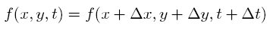
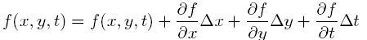
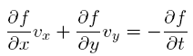
Gradient-based Optical Flow Solver
.
.
Optical flow evaluation
First-order approximation
(x, y, t)
(x + Δx, y + Δ y, t + Δt)
Frame t
Frame t + Δt
Gradient of pixel in x, y and t direction, known
One formula with two unknowns
Optical flow, unknown

Slide 52
Lucas Kanade Method
If we assume the pixel adjacent to the center has the same optical flow as the center
x-1,y-1 | x,y-1 | x+1,y-1
x-1,y | x,y | x+1,y
x-1,y+1 | x,y+1 | x+1,y+1
Let
Least Square Method

Slide 53
Image Derivative Computation
A
B
(A – B + C – D) / 2
C
D
frame n
A
B
(A – C + B – D) / 2
C
D
frame n
A
B
A - B
frame n
frame n+1

Slide 54
Lucas Kanade Method
Input: Frame n, frame n+1, window size w
Output: Optical flow field F
For each pixel x, y
Compute x,y,t derivative matrices Dx, Dy, Dt
for its neighbor window
Compute optical flow by the least square
method

Slide 55
Optimize Lucas Kanade Method on DSP
Derivative computation
SIMD arithmetic
Data interleaving
Least square method
Loop unrolling
SIMD load & arithmetic

Slide 56
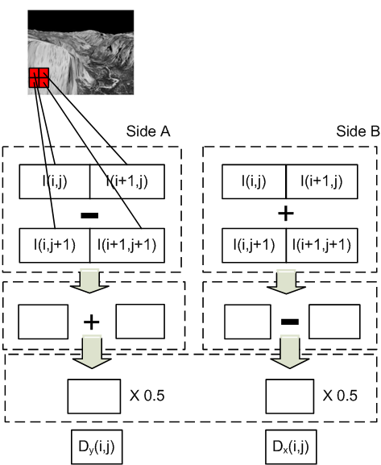
Derivative Computation
10 | 10 | 10 | 10
10 | 30 | 10 | 10
10 | 10 | 10 | 10
10 | 10 | 10 | 10
Derivative Computation (Dx, Dy)
-10 | 10 | 0
-10 | 10 | 0
0 | 0 | 0
-10 | -10 | 0
10 | 10 | 0
0 | 0 | 0
Cycle 1
Cycle 2
Interleave
-10 | -10 | 10 | -10 | 0 | 0
-10 | 10 | 10 | 10 | 0 | 0
0 | 0 | 0 | 0 | 0 | 0
Cycle 3

Slide 57
Least Square Method
Required computations
Dx
Dy
Dt
Multiplication x 5
DxDx
DxDy
DyDy
DxDt
DyDt
Accumulation x 5
Map to device
Dx
Dy
Dt
Dt
Complex Mul
2-way SIMD Mul
DxDy
-DyDy
DxDt
DyDt
DyDx
DxDx
(a+bj)(c+dj) = (ac-bd) + (ad+bc)j

Slide 58
Least Square Method
Unrolled 2x
Group up loads into SIMD operation
Load DxDy
Load Dt
Complex MUL
SIMD MUL
SIMD ADD
DxDy
Dt
-10 | -10 | 10 | -10 | 0 | 0
-10 | 10 | 10 | 10 | 0 | 0
0 | 0 | 0 | 0 | 0 | 0
0 | 0 | 0
0 | 20 | 0
0 | 0 | -20
(Dx,Dy,Dt)
200
0
200
0
0
(DxDx,DxDy,DyDy,DxDt,DyDt)
200
-10 | -10 | 0
-10
-10
0
100 | 100 | 100 | 0 | 0
100
100
100
0
0
0
+
200
(Dx,Dy,Dt)
(DxDx,DxDy,DyDy,DxDt,DyDt)
0
10 | -10 | 0
10
-10
0
100 | -100 | 100 | 0 | 0
100
-100
100
0
0
0

Slide 59
Loop Flattening
Software Pipelining
TI’s compiler technique to allow independent loop iterations be executed in parallel
The consecutive iterations are packed and executed together so that the arithmetic functional units are fully utilized
for (i = 0; i < m; ++i)
for (j = 0; j < n; ++j)
for (k = 0; k < m * n; ++k)
…
Update i, j;
j = 0
j = 1
j = 0
j = 1
Pipeline prologue/epilogue overhead

Slide 60
Multicore Utilization
Core 0
Core 1
Core 2
…
Derivative Computation
Least Square Method
Least Square Method
Least Square Method
…
Row [0, k)
Row [k, 2k)
Row [2k, 3k)
k = numRows / numCores
Cache sync

Slide 61
Accuracy Improvement
Cannot catch movement larger than window size
Gaussian Pyramid
A coarse to fine strategy for optical flow computation
Catches large movements
First order approximation may not be accurate
Iterative refinement
Iteratively process and offset pixels until the computed optical flow is converged
Introduce data random access

Slide 62
Experiment Setup
Platform | #Cores | Implementation | Power Measurement
TI C6678 DSP | 8 | Our Implementation | TI GPIO-USB Module
ARM Cortex A9 | 2 | Our Implementation | YOKOGAWA WT500 Power Analyzer
Intel i7-2600 | 4 | Our Implementation | Intel RAPL
Tesla K20 GPU | 2688 | OpenCV | NVIDIA SMI

Slide 63
Results and Analysis
Highest Performance
Tesla K20
Lowest Power
Cortex A9
Best Power Efficiency
TI C66x DSP
Platform | C66x | CortexA9 | Intel i7-2600 | K20
Actual Gflops/ Peak Gflops | 12% | 7% | 4% | 3%
Gflops | 15.4 | 0.7 | 17.1 | 108.6
Power (W) | 5.7 | 4.8 | 52.5 | 79.0
Gflops/W | 2.69 | 0.2 | 0.3 | 1.4

Slide 64
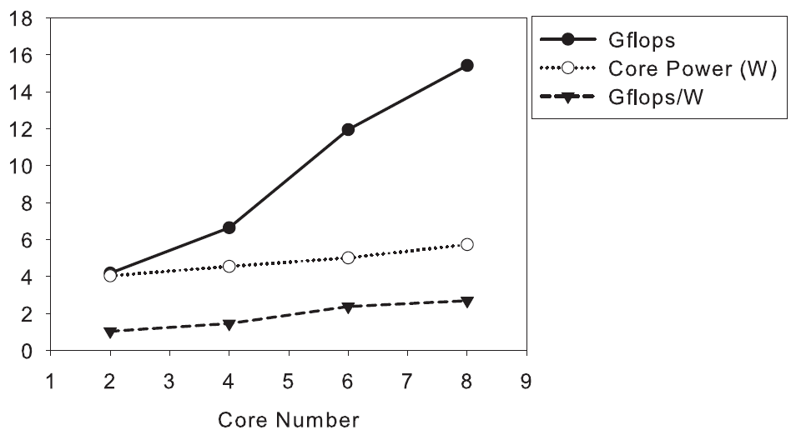
Results and Analysis
We achieve linear scalability on multi-cores
The power efficiency of the DSP is low when its cores are partially utilized
Static power consumption

Slide 65
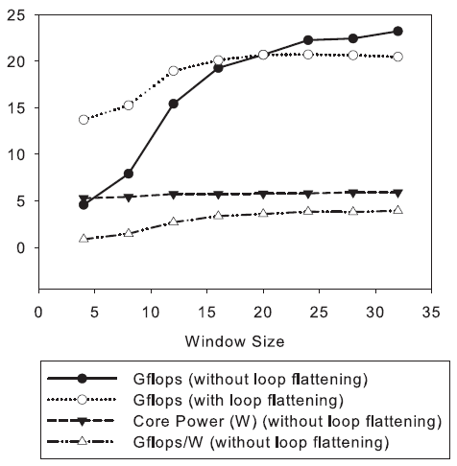
Results and Analysis
Performance are related with window size
Software pipeline performance
Loop flattening is able to improve performance significantly on small window size

Slide 66
Computational Biology
[FPGA, DSP, GPU]

Slide 67
Sequence Alignment
DNA/protein sequence, e.g.
TGAGCTGTAGTGTTGGTACCC => TGACCGGTTTGGCCC
Goal: align the two sequences against substitutions and deletions:
TGAGCTGTAGTGTTGGTACCC
TGAGCTGT----TTGGTACCC
Used for sequence comparison and database search

Slide 68
Needleman-Wunsch
Construct a score matrix, where:
Each cell (i,j) represents score for a partial alignment state
Sequence 1
A | B
C | D
Sequence 2
 |  | A | G | G | T | C | C | A | G | C | A | T
 |  |  |  |  |  | A | B
A |  |  |  |  |  | C | D
C
C
T
A
G
C
C
A
A
T
D = best score, among:
Add gap to sequence 1 from B state
Add gap to sequence 2 from C state
Substitute from A state
Final score is in lower-right cell

Slide 69
Needleman-Wunsch
 |  | A | G | G | T | C | C | A | G | C | A | T
 | D | L | L | L | L | L | L | L | L | L | L | L
A | U | D | D | L | L | L | L | L | L | L | L | L
C | U | U | D | D | D | L | L | L | L | L | L | L
C | U | U | D | D | D | D | L | L | L | L | L | L
T | U | U | U | D | D | D | L | L | L | L | L | L
A | U | U | U | U | U | U | L | L | L | L | L | L
G | U | U | U | U | U | U | D | L | L | L | L | L
C | U | U | U | U | D | D | D | D | L | L | L | L
C | U | U | U | U | U | D | D | D | L | L | L | L
A | U | U | U | U | U | D | D | D | L | L | D | L
A | U | U | U | U | U | U | U | D | L | L | D | D
T | U | U | U | U | U | U | U | U | U | D | D | D
Compute move matrix, which records which option was chosen for each cell
Trace back to get for alignment length
AmpliconNoise: Divide score by alignment length
match
substitute
substitute
match
gap s2
gap s2
match
match
match
gap s1
gap s1
L: left
match
U: upper
D: diagnal
match
Notes:
legend

Slide 70
Previous Work
Finely parallelize single alignment into multiple threads
One thread per cell on the diagonal
Disadvantages:
Complex kernel
Unusual memory access pattern
Hard to trace back
1 | 2 | 3 | 4 | 5 | 6 | 7 | 8 | 9
2 | 3 | 4 | 5 | 6 | 7 | 8 | 9 | 10
3 | 4 | 5 | 6 | 7 | 8 | 9 | 10 | 11
4 | 5 | 6 | 7 | 8 | 9 | 10 | 11 | 12
5 | 6 | 7 | 8 | 9 | 10 | 11 | 12 | 13
6 | 7 | 8 | 9 | 10 | 11 | 12 | 13 | 14
7 | 8 | 9 | 10 | 11 | 12 | 13 | 14 | 15
8 | 9 | 10 | 11 | 12 | 13 | 14 | 15 | 16
9 | 10 | 11 | 12 | 13 | 14 | 15 | 16 | 17
Block Wave Line

Slide 71
Our Method: One Thread/Alignment
1 | 2 | 3 | 4 | 5 | 6
7 | 8 | 9 | 10 | 11 | 12
13 | 14 | 15 | 16 | 17 | 18
19 | 20 | 21 | 22 | 23 | 24
25 | 26 | 27 | 28 | 29 | 30
31 | 32 | 33 | 34 | 35 | 36
Block Stride
1 | 2 | 3 | 4 | 5 | 6
7 | 8 | 9 | 10 | 11 | 12
13 | 14 | 15 | 16 | 17 | 18
19 | 20 | 21 | 22 | 23 | 24
25 | 26 | 27 | 28 | 29 | 30
31 | 32 | 33 | 34 | 35 | 36
1 | 2 | 3 | 4 | 5 | 6
7 | 8 | 9 | 10 | 11 | 12
13 | 14 | 15 | 16 | 17 | 18
19 | 20 | 21 | 22 | 23 | 24
25 | 26 | 27 | 28 | 29 | 30
31 | 32 | 33 | 34 | 35 | 36
1 | 2 | 3 | 4 | 5 | 6
7 | 8 | 9 | 10 | 11 | 12
13 | 14 | 15 | 16 | 17 | 18
19 | 20 | 21 | 22 | 23 | 24
25 | 26 | 27 | 28 | 29 | 30
31 | 32 | 33 | 34 | 35 | 36
1 | 2 | 3 | 4 | 5 | 6
7 | 8 | 9 | 10 | 11 | 12
13 | 14 | 15 | 16 | 17 | 18
19 | 20 | 21 | 22 | 23 | 24
25 | 26 | 27 | 28 | 29 | 30
31 | 32 | 33 | 34 | 35 | 36
Memory access pattern
Block Wave Line

Slide 72
Grid Organization
Example:
320 sequences
Block size=32
n = 320/32 = 10 threads/block
(n²-n)/2 = 45 blocks
Objective:
Evaluate different block sizes
Block 0
Sequences
0-31
Sequences
32-63
…
…
Block 1
Sequences
0-31
Sequences
64-95
…
…
…
…
Block 44
Sequences
256-
287
Sequences
288-
319
…
…

Slide 73
Optimization Procedure
Optimization Aim: to have more matrices been built concurrently
Available variables
Kernel size(in registers)
Block size(in threads)
Grid size(in block or in warp)
Constraints
SM resources(max schedulable warps, registers, share memory)
GPU resources(SMs, on-board memory size, memory bandwidth)

Slide 74
Kernel Size
Make sure the kernel as simple as possible (decrease the register usage)
→ our final outcome is a 40 registers kernel.
Fixed Parameters
Kernel Size | 40
Block Size | -
Grid Size | -
Constraints
max support warps
registers
share memory
SMs
on-board memory
memory bandwidth

Slide 75
Block Size
Block size alternatives
Fixed Parameters
Kernel Size | 40
Block Size | 64
Grid Size | -
Constraints
max support warps
registers
share memory
SMs
on-board memory
memory bandwidth

Slide 76
Grid Size
The ideal warp number per SM is 12
W/30 SMs => 360 warps
In our grouped sequence design
the warps number has to be multiple of 32.
Fixed Parameters
Kernel Size | 40
Block Size | 64
Grid Size | 160
Blocks | Warps | Time(s)
160 | 320 | 11.3
192 | 384 | 12.7
224 | 448 | 12.2
Constraints
max support warps
registers
share memory
SMs
on-board memory
memory bandwidth

Slide 77
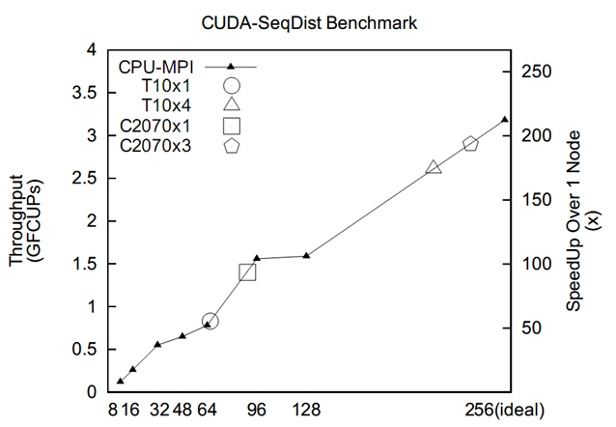
Results
FCUPs:
floating point cell update per second
Cluster: 40Gb/s Inifiniband
Xeon X5660
Number of Ranks in our cluster

Slide 78
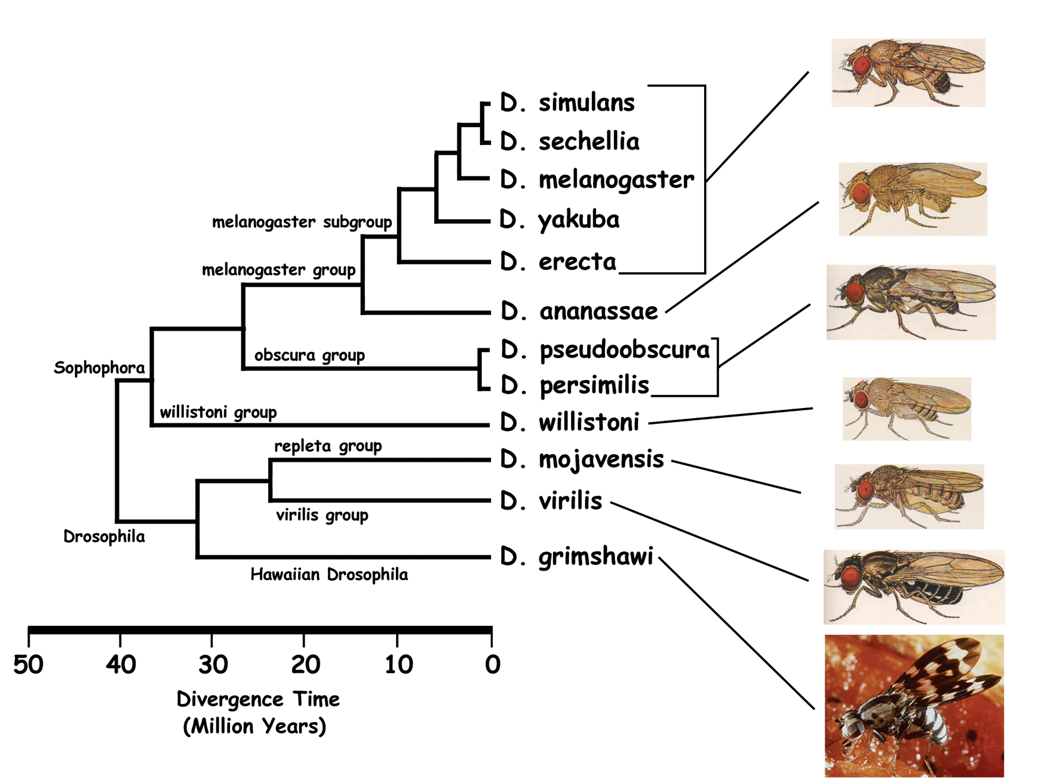
Phylogenies
genus Drosophila

Slide 79
Phylogeny Data Structure
g3
g1
g4
g2
g1
g3
g2
g5
g5
g5
g6
g4
g6
Unrooted binary tree
n leaf vertices
n - 2 internal vertices (degree 3)
Tree configurations =
(2n - 5) * (2n - 7) * (2n - 9) * … * 3
200 trillion trees for 16 leaves
g6
g3
g5
g2
g1
g4
g5

Slide 80
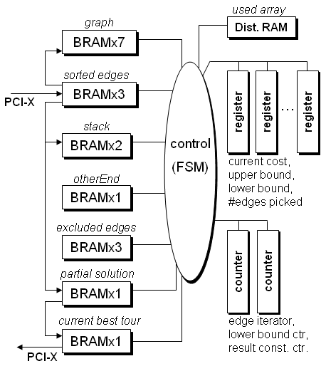

Hardware Median Core Design
Top-Level
Controller

Slide 81
Parallelizing the Median Computation
Exploit both fine- and coarse- grain parallelism
Fine-grain
Unroll loop for lower bound computation
Perform multiple iterations in parallel
Coarse-grain
Use parallel median cores for single median computation
Partition search space

Slide 82
Fine-Grain Parallelism
Lower bound unit:
v=2
e₀=11
e₁=-19
e₂=-49
used
table
used(v)
used(e₀)
used(e₁)
used(e₂)
if used(v) = 0 then
VALID_WEIGHTS= φ
for i = 0 to edge_count(v) - 1
if used(e_{i}) = 0 and
otherEnd(v) != e_{i} and
excluded_{i}(v) != 1 then
add weight_{i} to VALID_WEIGHTS
end if
end loop
if VALID_WEIGHTS is empty
lower_bound = lower_bound + 3
else
lower_bound = min(VALID_WEIGHTS)
end if
TSP graph representation:
1 (1,-4),w=0
-1 (-1,9),w=1 (-1,25),w=2
2 (2,11),w=2 (2,-19),w=2 (2,-49),w=2
-2 (-2,17),w=2 (-2,20),w=1
.
.
.
-19 (-19,2),w=2 (-19,-4),w=2 (-19,10),w=2
.
.
.
otherEnd
table
v=2
otherEnd(v)
v=2
excluded
table
excluded₀(v)
excluded₁(v)
excluded₂(v)
v=2
edge_count
table
3
11
-19
weight₀
weight₁
weight₂
2
2
2
2
2
2
2
-49

Slide 83

Experimental Results: Median Acceleration
Best performance was achieved:
20 lower bound units per core
2 cores
~ 50% of FPGA resources
Performance improves with size of search space
i.e. search time
Host-FPGA communication overhead
Average speedup for 1000 median computations

Slide 84
Data Mining
[FPGA, GPU]

Slide 85

Eclat Algorithm

Slide 86

Hardware Architecture

Slide 87


Hardware Architecture

Slide 88
Design Space Exploration with Scratchpad memory
Dataset | Threshold | Sw baseline | Running time w/o scratchpad | 256-bit speedup | 128-bit speedup | 2048 Kb scratchpad | Running time | Overall Speedup
T40I10D0_3N500K | 0.01 | 819.5 | 21.334 | 4.92 | 2.85 | 2.02 | 10.561 | 77.594
T40I10D0_3N1000K | 0.02 | 270.6 | 7.132 | 4.76 | 2.72 | 1.6 | 4.458 | 60.707
T60I20D0_5N500K | 0.02 | 393.5 | 12.519 | 4.64 | 2.68 | 1.98 | 6.323 | 62.236
T90I20D0_5N500K | 0.05 | 685.3 | 29.25 | 4.39 | 2.53 | 1.94 | 15.077 | 45.452
T40I200U128 | 0.02 | 291.26 | 7.93 | 4.78 | 2.86 | 1.99 | 3.985 | 73.090
T40I200U1024 | 0.01 | 289.13 | 7.579 | 4.64 | 2.79 | 2 | 3.790 | 76.298
T40I800U128 | 0.02 | 750.07 | 2.47 | 3.03 | 2.26 | 1.79 | 1.380 | 543.573
T40I800U1024 | 0.01 | 61.4 | 1.698 | 3.92 | 2.78 | 1 | 1.698 | 36.160

Slide 89
Tools
[FPGA, DSP]

Slide 90
High-Level Synthesis
Input bandwidth-constrained high-level synthesis
Example: 16-input expression:
out = (AA1 * A1 + AC1 * C1 + AG1 * G1 + AT1 * T1) *
(AG2 * A2 + AC2 * C2 + AG2 * G2 + AT2 * T2)

Slide 91


Results

Slide 92



Stencil Loop
Performed on arrays, matrices or multi-dimensional grids
Update array elements from their neighbors
Input
3
6
9
6
3
B[i] =(A[i-1] + A[i] + A[i+1]) / 3
3 point mean filter
Output
6
7
6
1D horizontal
(A)
1D vertical
(B)
2D
(C)

Slide 93
Methodology Overview
Code Generation
PIA syntax design
LLVM code generation
Stencil body generation
Loop structure generation
Code Optimization
Loop unroll
SIMD binding
Address alignment detection
Iterative optimization
Memory Management
Loop tiling and buffering
Double buffer rotation

Slide 94
Syntax Design
We do not use C language
We can make it grammatically simpler
We design a Domain-Specific Language to simplify the representation of stencil loops
No need to design control flow
No addressing computation in the body of the loop
Position Independent Arithmetic (PIA)
void matrix_add(float* A, float* B, float* C, int N) {
for (i = 0; i < N; ++i) {
for (j = 0; j < N; ++j) {
C[i * size_x + j] =
A[i * size_x + j] + B[i * size_x + j];
}
}
}
STENCIL(matrix_add)
C = A[0,0] + B[0,0];
END
C code
PIA code

Slide 95
Syntax Design
Started with “STENCIL(func_name)” and ended with “END”
Elements from the input arrays are referred with an offset modifier.
A[1, -1] means A[(i + 1) * size_x + j – 1]
B[1, -2, 3] means B[(i + 1) * size_y * size_x + (j – 2) * size_x + k + 3]
Local variables begin with “$”, they could be used to store temporary values.
Parameters begin with “@”, they are used to pass in values from the outside of the stencil function, such as coefficients.
STENCIL(foo)
$t = A[-1,0] * @c1 +
A[0,0] * @c2 +
A[0,1] * @c3;
C = 1.0 / $t;
END
Input
Parameter
Local Variable
Output

Slide 96
Stencil Body Generation
PIA syntax is designed with Context-Free Grammar
Lexical parser: Flex
Syntax parser: Bison
Abstract syntax tree: C++
Traverse syntax tree and generate LLVM IR code
Input arrays : Generate addressing and load operations
Arithmetic operation : Generate Add, Sub, Mul, Div, etc
Assignment operation : Generate move or store operations
The code generation is implemented on top of LLVM API.

Slide 97


Results of Loop Unrolling

Slide 98

Results of SIMD Binding
Provide up to 2x speed up
More efficient on complex loops

Slide 99

Results of Alignment Detection
Reduce up to 30% of II

Slide 100


Slide 101


Speed-up over Cache

Slide 102



Speed-up over Cache

